Slide 1


Data Analytics

Slide 2


Today's agenda
Project recap
Problem
The Analytics team
Process
Insights
Summary

Slide 3

Social Buzz is a fast-growing technology unicorn that need to adaqt quickly to its global scale.
Accenture has begun a 3-month POC focusing on these tasks:
An audit of Social Buzz’s big data practice
Recommendation for the successful IPO
Analysis to find social buzz top 5 most popular categories of the content.
Project Recap

Slide 4

Problem
Over 100000 posts per day
36,500,000 pieces of content per year!
But how to capitalize on it when there is so much?
Analysis to find Social Buzz’s top 5 most popular categories of the content

Slide 5



Andrew Fleming
Chief Technical Architect
The Analytics team
Marcus Rompton
Senior Principal
Naman Singhvi
Data Analyst

Slide 6
Process
1
Data Understanding
2
Data Cleaning
3
Data Modeling
4
Data Analysis
5
Uncover Insights

Slide 7

Insights
16
1897
JANUARY
Unique Categories
Reactions to “Animal” Posts
Month with Most Posts

Slide 8
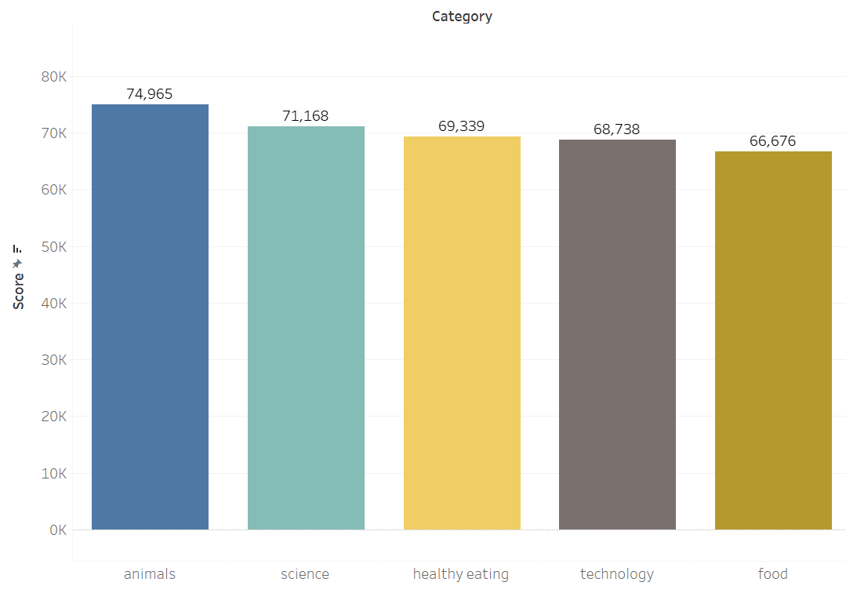
Top 5 Categories by aggregate “Popularity” score

Slide 9
Popularity percentage share from top 5 categories

Slide 10

ANALYSIS
Animals and science are the two most popular categories of content, showing that people enjoy “real life” and “factual” content the most.
INSIGHT
Food is a common theme with the top 5 categories with “Healthy Eating” ranking the highest. This may give an indication to the audience within your user base. You could use this insight to create a campaign and work with healthy eating brands to boost user engagement.
NEXT STEPS
This ad-hoc analysis is insightful, but its time to take this analysis into large scale production for real time understanding of your business. We can show you how to do this.
Summary

Slide 11
Thank you!
ANY QUESTIONS?

